Slide 1

https://www.uni-goettingen.de/en/48115.html
UNPLAB-BrMeth_Ch-10[TheFour III]
Maintenance; Back-Cross

Slide 2
Sequential Number: #28
UNPLAB-BrMeth_Ch-10[TheFour III]
Unless I explicitly state otherwise, images and cartoons are created using ChatGPT.
You may use this material free of charge under the terms of the CC BY license. This requires that you provide appropriate attribution to the author: W. Link, University of Goettingen, Germany.
In a few cases, individual images, photographs, or similar material may be subject to a more restrictive Creative Commons license. Where this applies, it is explicitly indicated, and you must comply with the stated license terms for those items.
Please check the license information carefully before reuse. Responsibility for complying with the applicable license terms rests entirely with you.
2

Slide 3
You already know:
Population Genetics. Genotype frequency, Allele frequency, Hardy-Weinberg-Equilibrium, Inbreeding coefficient, Kinship, Selection, Drift, Migration, Mutation. And GxE with heritability and the Breeder’s Equaiton.
And you have already studied Recurrent Selection.
You already have seen several Line Breeding Methods.
Keywords of this chapter: Maintenance Breeding, Backcross with Foreground Selection and Background Selection
Algebra as introduced in this chapter:
Expected dose [%] of Recurrent Parent genome in generation BC(t) = (1-0.5 ^{t+1}) ∙ 100
3

Slide 4
We have seen phenotype-based Breeding Methods in Line Breeding.
As next topic, we visit the question: „How do breeders maintain, conserve a once-bred superior cultivar“?
And then, we shall visit the question: „How may breeders improve a once-bred, superior cultivar for a single, specific features that is not yet optimally realized (such as a resistance)?
Only after this we will then visit the remaining Breeding Categories.
4

Slide 5

More than 50% of time, budget, work is invested into so-called ‘Maintenance Breeding*’
In the right-hand part of the image, the unharvested plots are those that were not harvested due to suspected type deviation.
Left: Not-yet purified – not yet harvested.
Maintenance breeding. Cultivars need a continuous purification, to maintain their morphological features and agro-nomic performance. This is especially important if e.g. a line cultivar was developed from an early generation indivi-dual such as F3 or F4 (i.e., if the cultivar is a F3 or F4-derived partial bulk). Because in such case, we would ‘invite’ Natural Selection to subliminally change our cultivar. Mutation and accidental contamination with alien seed (or pollen) have similar effects. Each year, many single ears (or plants) of the cultivar are taken and their progenies are grown to check phenotype and hence remove all (visible) off-types (so-called ‘negative’ selection).

Slide 6
A scheme to conduct Maintenance Breeding (for a self-fertilizing crop such as barley).
DNA data (genotyping) is increasingly employed to assist in the maintenance of cvs.
Identify true-to-type plants of your cv.; grow them ‘ear-to-row’
Bulk harvest true-to-type lines for ‘Prebasic’ seed.
Year 2026
Bulk-harvest
‘Prebasic’
Year 2027
Bulk-harvest
‘Basic’
Year 2028
Bulk-harvest
Certified seed
Year 2029
Bulk-harvest
Farmer

Slide 7

A scheme to conduct Maintenance Breeding (for a self-fertilizing crop such as barley).
Probably DNA data (genotyping) will increasingly be employed to assist in the maintenance of cvs.
Identify true-to-type plants of your cv.; grow them ‘ear-to-row’
Bulk harvest true-to-type lines for ‘Prebasic’ seed.
Identify true-to-type lines; grow ear-to-row offspring for further true-to-type selection.
Year 2025
Bulk-harvest
‘Prebasic’
etc.
etc.
Year 2025
Bulk-harvest
‘Basic’
Prebasic
etc.
Seed production is a highly regulated §§ and controlled task.
https://deutsche-saatguterzeuger.de/
Year 2025
Bulk-harvest
Certified seed
Basic
Prebasic
www.z-saatgut.de
www.escaa.org
Year 2025
Bulk-harvest
Farmer
Certified seed
Basic
Farmer
Certified seed
7

Slide 8
Once an elite cultivar is released, approved, accepted by the farmers and further customers, one will for sure find out … well, it still has a shortcoming, a tiny bug. How to improve a standing, maybe even famous cultivar for a single, specific feature – without changing it otherwise ?
●Mutagenesis ●Agrobact.-mediated gene transfer (or other ways
of gene transfer) ●CRISPR-Cas9
For the GMO approaches, we need to ‘know’ the gene, the sequence.
●In some cases (fruit trees, grapevine, …): Grafting
Or else … Recurrent Backcrossing! For this, we don’t need to know the gene - but we need a ‘geniteur’, one who ‘has’ and ‘gives’ the gene(s).
We need a ‘meiotically accessible’ gene-donor’, so to speak.
8

Slide 9
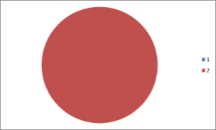
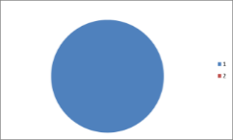
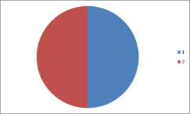
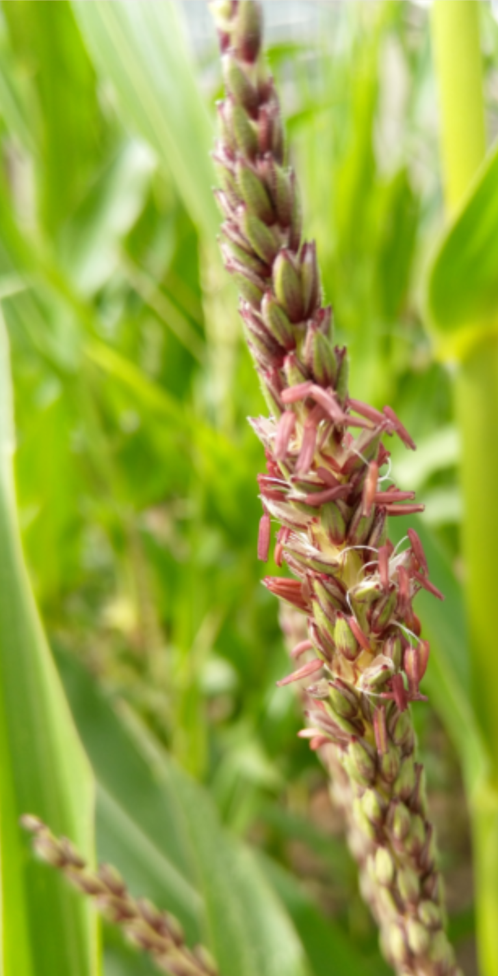
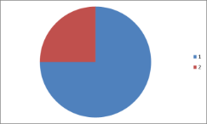
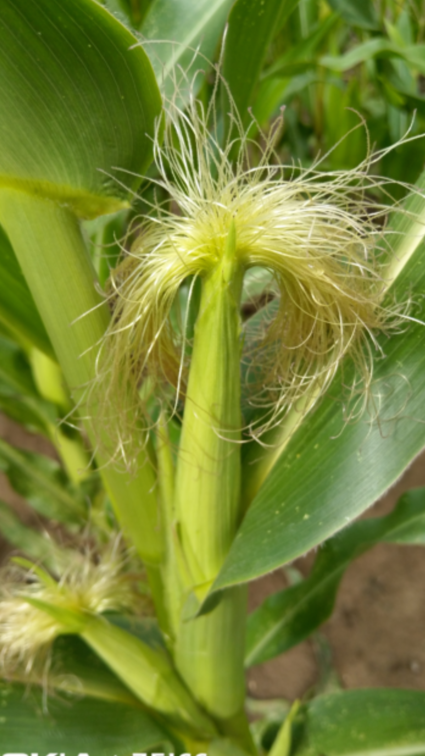
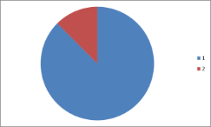
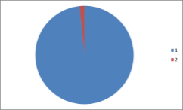
With Recurrent Backcrossing to a homozygous parent, the genome dose of that recurrent parent increases in half-steps until - after few back-crosses - it approaches 100%.
X
Donor
Recurrent parent
X
F₁
Recurrent parent
Corn tassel with pollen
Corn ear with silk
X
BC₁(F₁)
Recurrent parent
X
Pollen
BC2(F₁)
Recurrent
parent
et cetera
BC1 seed grows on ear
BC5(F₁)
© WL
F1 (Donor x Elite)
Elite pure line
9

Slide 10
With Recurrent Backcrossing to a homozygous recurrent parent, the genome dose of that parent increases in half-steps until - after few back-crosses - it approaches 100%.
Let us, just for curiosity, ponder a while on whether these figures are exact or have some kind of exploitable variance (yes, they do) ☺
Is the composition of the F1 exactly 50:50? Yes, indeed, given ‚normal‘ settings such as autosomal loci.
Of course, backcrossing is towards the recurrent parent (here, P2; elite).
Does the BC1, more exactly the BC1(F1) ...
– this is the outcome of the first back-crossing, i.e. ‘F1 x P1’ (or F1 x P2
or P1 x F1 or P2 x F1)
… does it indeed carry 25 : 75 of the genes from P1 and P2?
Yes indeed: As expected average.
That average is not exactly true for each of the segregating
BC1F1 individuals. It is just their average P1 dose.
75
75
For ease, we will first consider this topic in F2 instead of in BC1. So we first ask: Does the usual Mendelian F2 contain exactly 50:50 gene dose (share) of its two initial (grand-)parents P1 and P2?
10

Slide 11
Consider F2. Does the usual Mendelian F2 contain exactly 50:50 gene dose (share) of its two initial parents* P1 and P2 (*honestly P1 and P2 were the grandparents)?
Let us, just for curiosity, ponder a while on whether these figures are exact or have some kind of expected variance. ☺
Is the composition of the F1 exactly 50:50? Yes, indeed, given ‚normal‘ settings such as autosomal loci.
A locus that was heterozygous in F1, such locus will be heterozygous in F2 for 50% of the F2 individuals and homozygous (¼ + ¼) for 50% of cases. The he-terozyous F2 individuals are clearly composed 50:50. One ¼ fraction of individuals is 100% like P1, the other ¼ fraction is 100% like P2. So (1) on average 50:50 is true and (2) there is variation; ¼ are like P1, ½ are half like P1, ¼ are zero like P1 (always: At the focal locus) ...
We look at N=1 locus. We continue to stick to N=1, but …
... we assume that the genome ‚has‘ only N=1 chromosome; and no cross-over! See left diagram. In F2, variance for the genome-wide P1-dose then is
σ²_{P1}=¼ (1.0-0.5)² + ½ (0.5-0.5)² + ¼( 0.0-0.5)² = 1/8
N
=1
σ
2
= 1/8
P1
1/2
1/4
1/4
0.0
1/2
1.0
Parent P1 dose
11

Slide 12
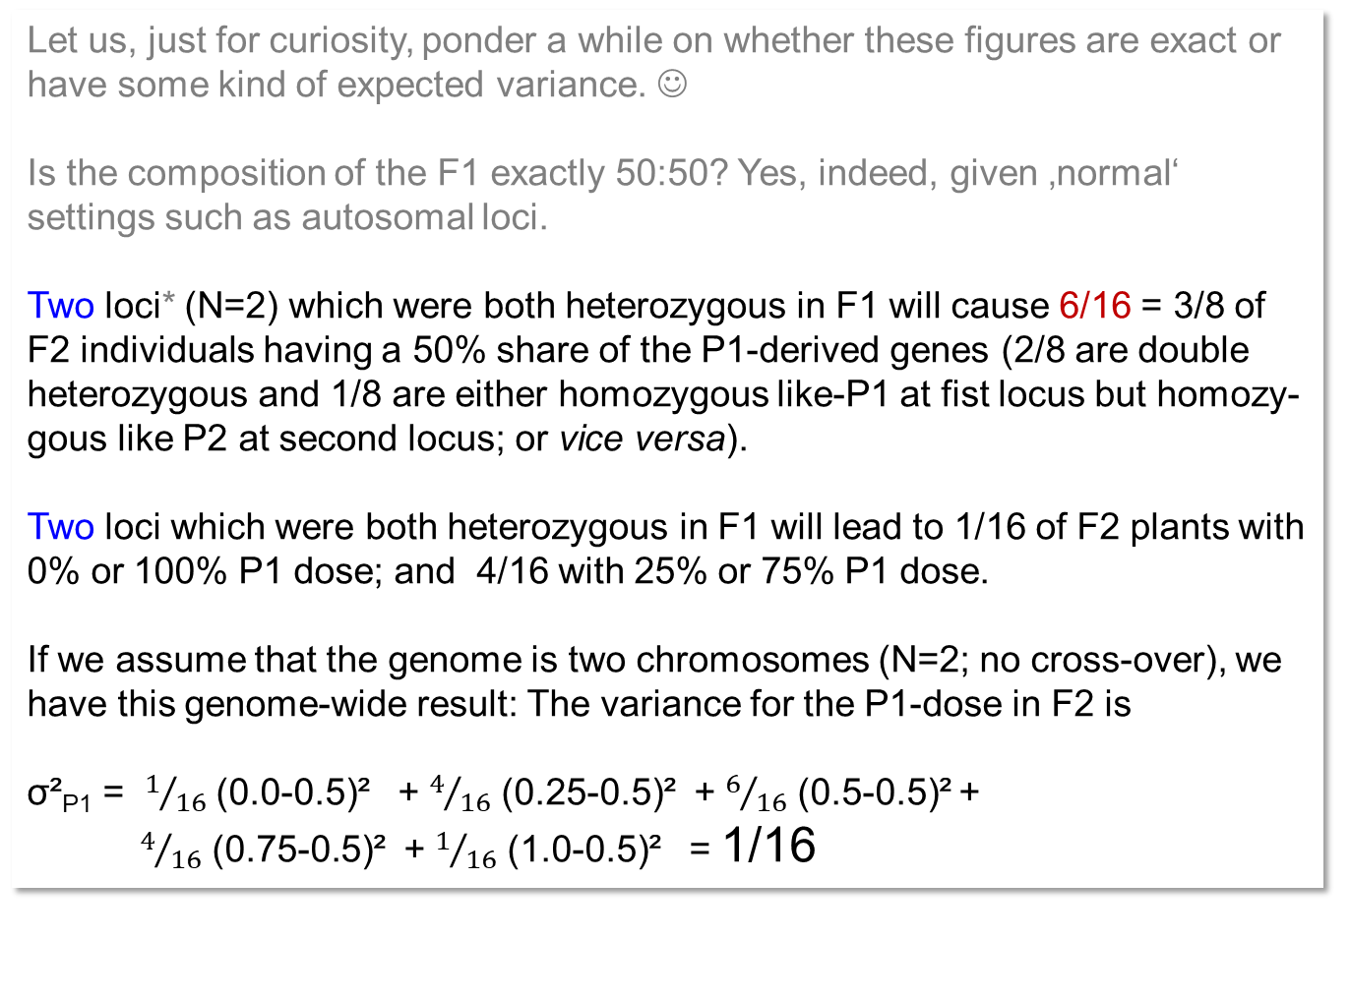
Consider F2. Does the usual Mendelian F2 contain exactly 50:50 gene dose (share) of its two initial parents P1 and P2?
Let us, just for curiosity, ponder a while on whether these figures are exact or have some kind of expected variance. ☺
Is the composition of the F1 exactly 50:50? Yes, indeed, given ‚normal‘ settings such as autosomal loci.
Two loci* (N=2) which were both heterozygous in F1 will cause 6/16 = 3/8 of F2 individuals having a 50% share of the P1-derived genes (2/8 are double heterozygous and 1/8 are either homozygous like-P1 at fist locus but homozy-gous like P2 at second locus; or vice versa).
Two loci which were both heterozygous in F1 will lead to 1/16 of F2 plants with 0% or 100% P1 dose; and 4/16 with 25% or 75% P1 dose.
If we assume that the genome is two chromosomes (N=2; no cross-over), we have this genome-wide result: The variance for the P1-dose in F2 is
σ²_{P1} = $1/{16}$ (0.0-0.5)² + $4/{16}$ (0.25-0.5)² + $6/{16}$ (0.5-0.5)² +
$4/{16}$ (0.75-0.5)² + $1/{16}$ (1.0-0.5)² = 1/16
N=2
σ²_{P1} = 1/16
1/16
4/16
6/16
4/16
1/16
*unlinked, of course
0.0
1/4
1/2
3/4
1.0
Parent P1 dose
12

Slide 13
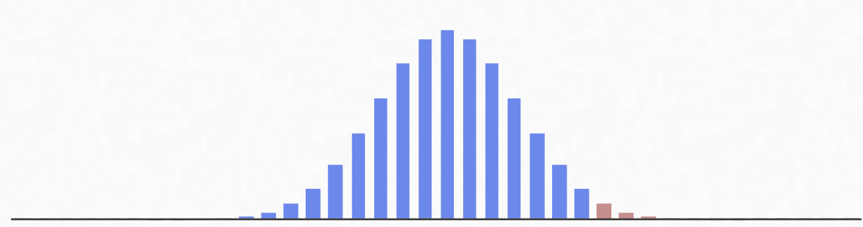
Consider F2. The more chunks-of-genome segregate independently (N=1, N=2, etc.), the smaller is the variance for the genomic dose of P1 (or P2) between F2 plants.
Maize (and sorghum and soya bean ...) have 2∙10 chromosomes, i.e. 10 chunks of their genome are distributed independently from each other in meiosis (not yet taking cross-over into account). During meiosis, each maize chromosome breaks into (a bit more than) 2 chunks (cross-over), i.e. slightly more than 20 fragments of the genome take independent paths in meiosis (are distributed independently of each other to the four daughter cells).
So, N≈20
With N=1, σ²_{P1} =1/8
With N=2, σ²_{P1} =1/16. You see it anyway.
With N, σ²_{P1} =1/(8N). Well, if the chromosomes and the pieces into which they break are of same size. This is of course not exactly true. We developed only a rule-of-thumb. A rough approximation. The probability to find an F2-individual with 14 or more chunks which are all from P1 is roughly about 2%.
N=2
σ²_{P1} = 1/16
Take home message: In segregating generations such as F2 or BC, there is variation for the genetic dose of P1 (and of P2).
That variation can be exploited.
F2 plants with nearly 75% dose P1 can be found in F2, although the expectation is 50%.
1/16
4/16
6/16
4/16
1/16
N=20
σ²_{P1} = 1/160
0.0
1/4
1/2
3/4
1.0
0
10
14
20
Parent P1 dose
13
P1 pieces of chromosome

Slide 14
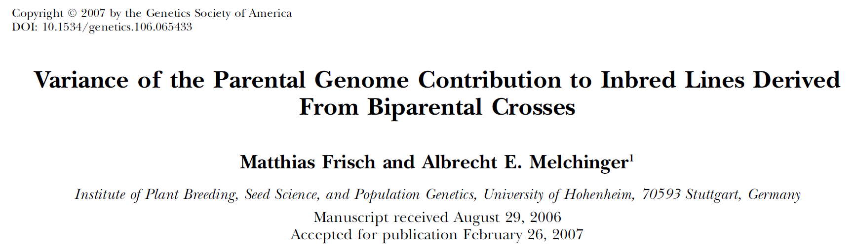
The more chunks-of-genome (“haploid number of segments” in Hillel et al., 1989) that segregate independently (N=1, N=2, etc.), the smaller is the variance for the genomic dose of P1 (or P2) between F2 plants.
2N=10
N, the ‚haploid‘ number of segments.
With N=5 (2N=10; Arabidopsis thaliana) and ~one cross-over per bivalent, the total number of segments is 2 times 5 = 10.
14

Slide 15
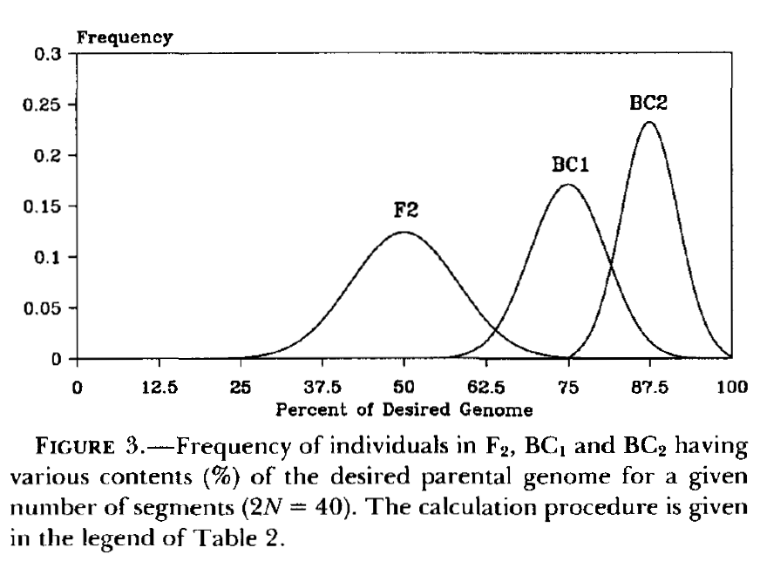
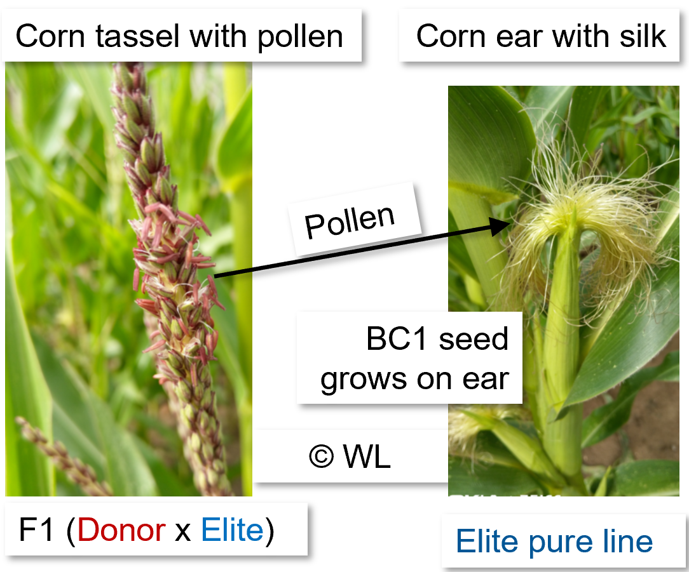
The same basic reasoning applies to the Backross-generations. The individuals differ from each other for their elite-parent genetic dose, and the higher that dose is,...
... the better it is, well, as long as the focal gene (the ‘reason’ to start the back-cross scheme) is still available in the selected BC-individuals.
Strict marker-based selection bet-ween F2-plants in favour of high dose of elite-parent genome should detect individuals with elite dose of nearly 75% - which is the expected value one generation later (BC1).
Marker-based selection allows to save more or less one generation. This here is the so-called Back-ground-selection in Backcross schemes.
Hillel et al., 1989
Frisch and Melchinger, 2007
15

Slide 16
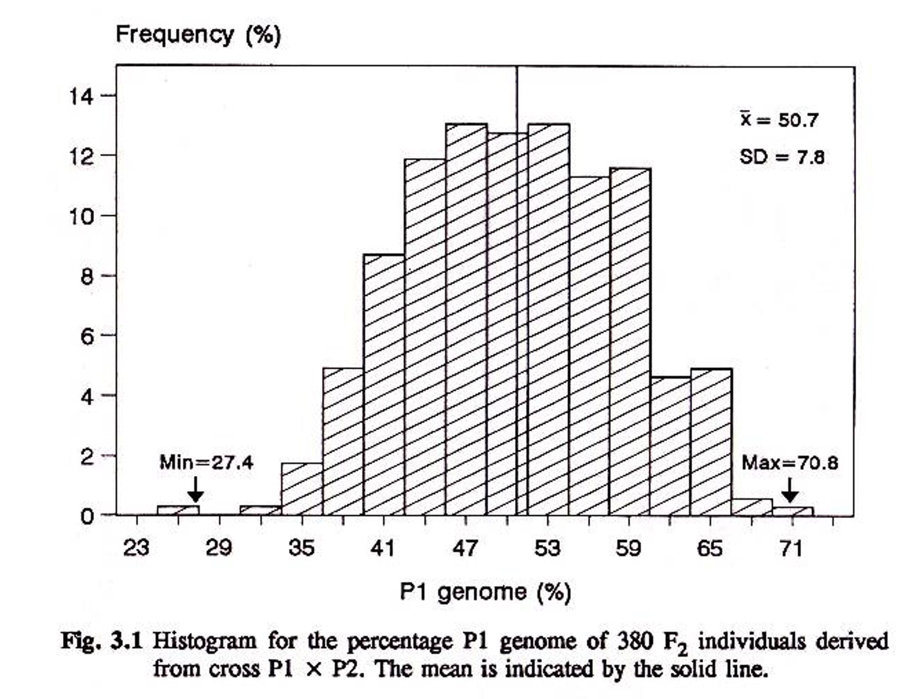
Histogram for percent of P1 genome as realized in 380 bi-parental (Mendelian) F2-individuals. Percent P1 dose estimated from RFLP marker analyses (Schön, 1993).
This is, you guess it, one of the things I like very much :-) ... tinkered by ourselves (no AI), just rough, but still not too bad as a proxy.
From our earlier, simple and rough reasoning, we had σ²_{P1} =1/(8N).
Eva Bauer, TUM 27.09.2012 10:52: ‘Our maize showed N = 23.8 as mean number of ‚haploid chromosomal segments‘. Hence, σ²_{P1} =1/8N= =0.00525; hence SD = σ_{P1} =0.0725
On a percent scale as used in this diagram (maize data from Schön, 1993), this is
SD = 7.25%; our rough reasoning is barely different from the experimental result:
SD = 7.8%.
Indeed, a marker-based strict selection would have resulted in one F2 individual that has > 70% P1 genome; nearly as if it was a BC1 individual (backcross towards P1). And in one F2 individual that has only about 25% P1 genome just as if it was a typical member of BC1 (backcross towards P2).

Slide 17
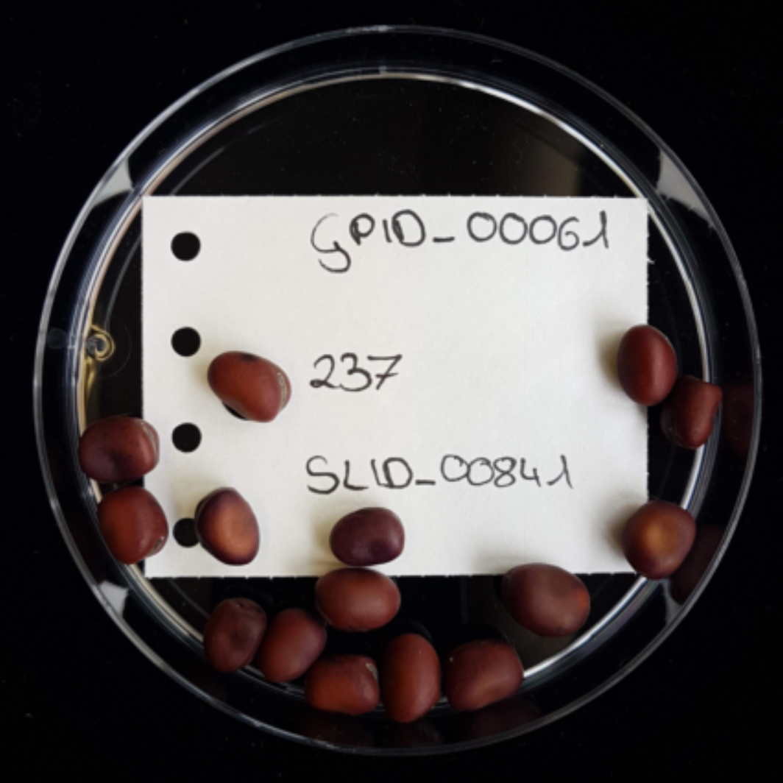
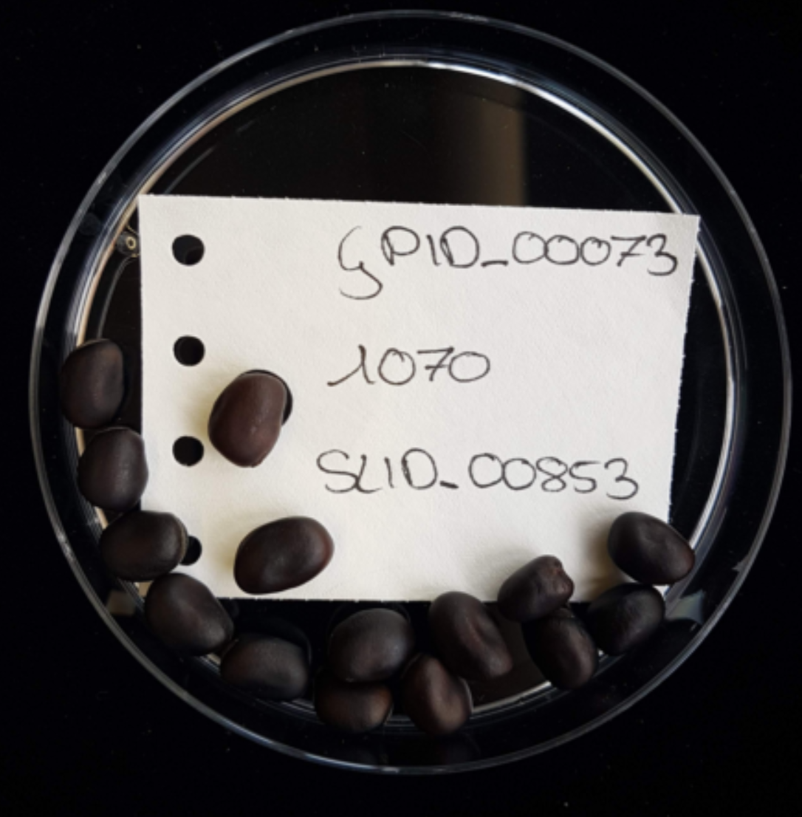
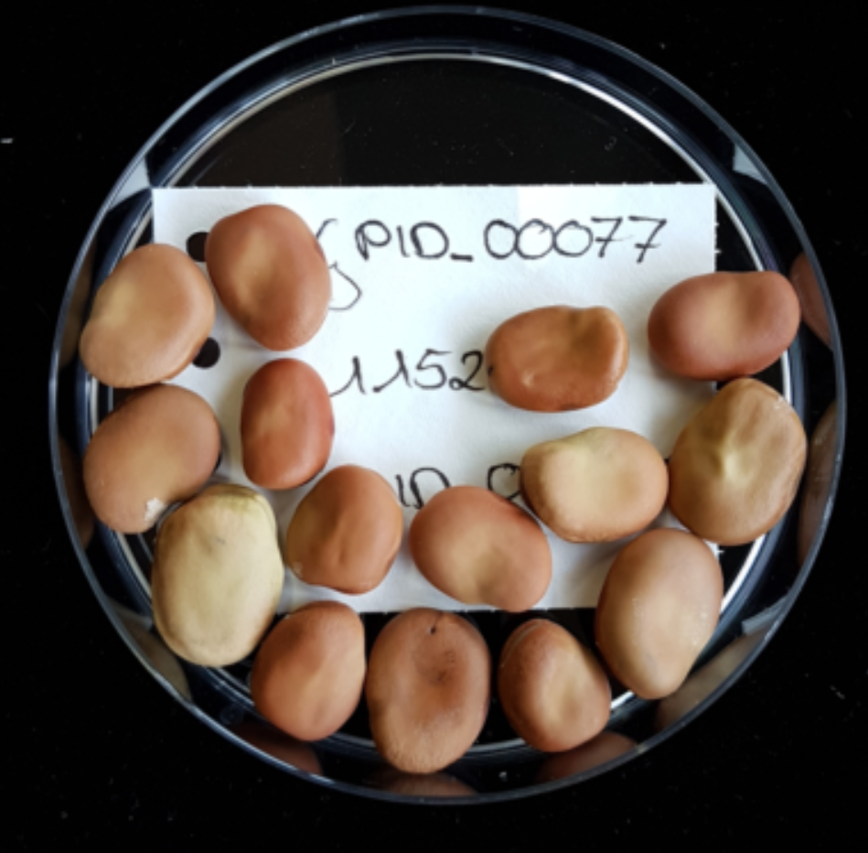
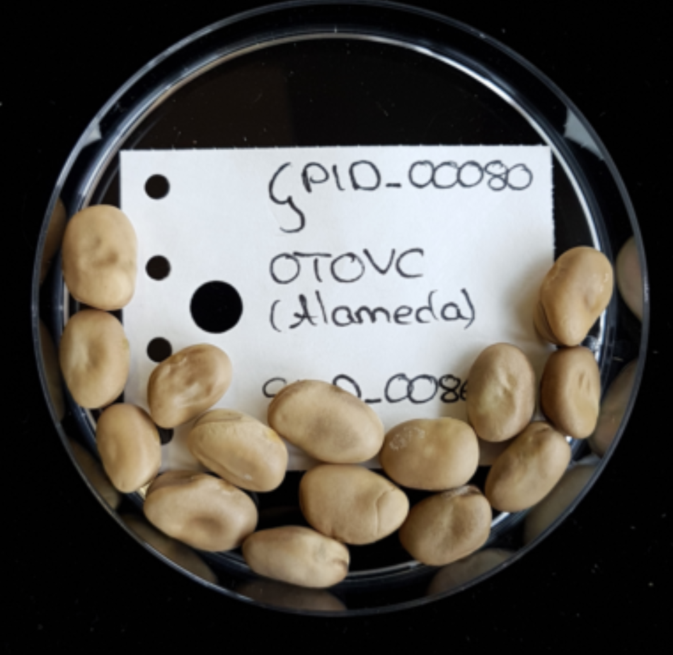
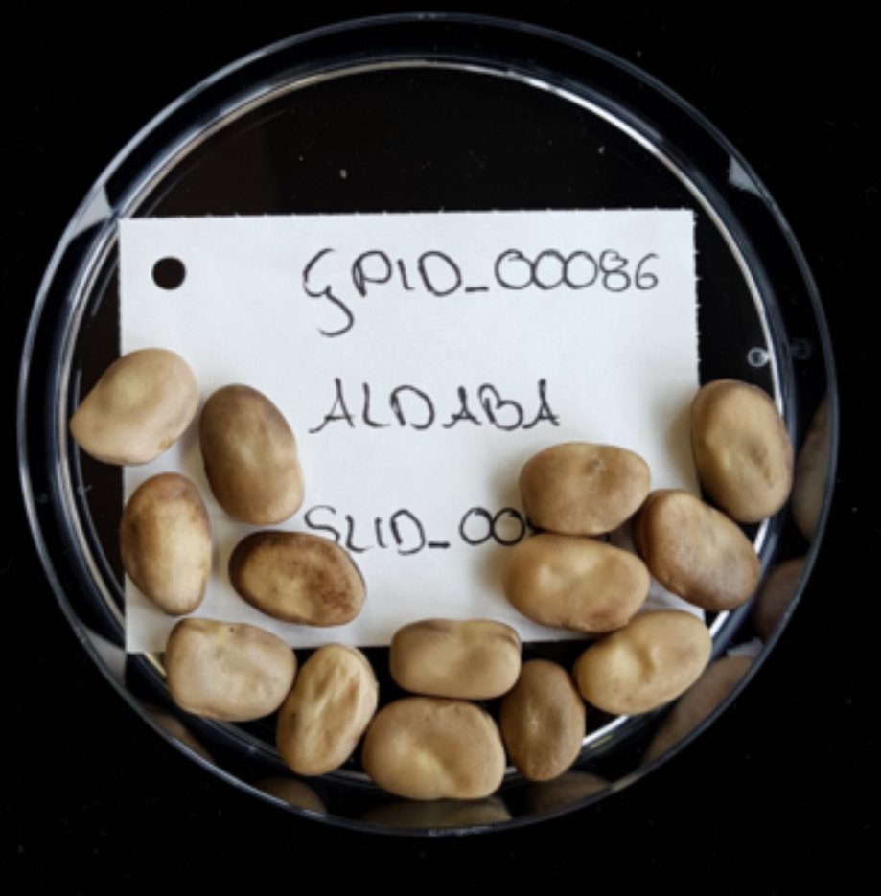
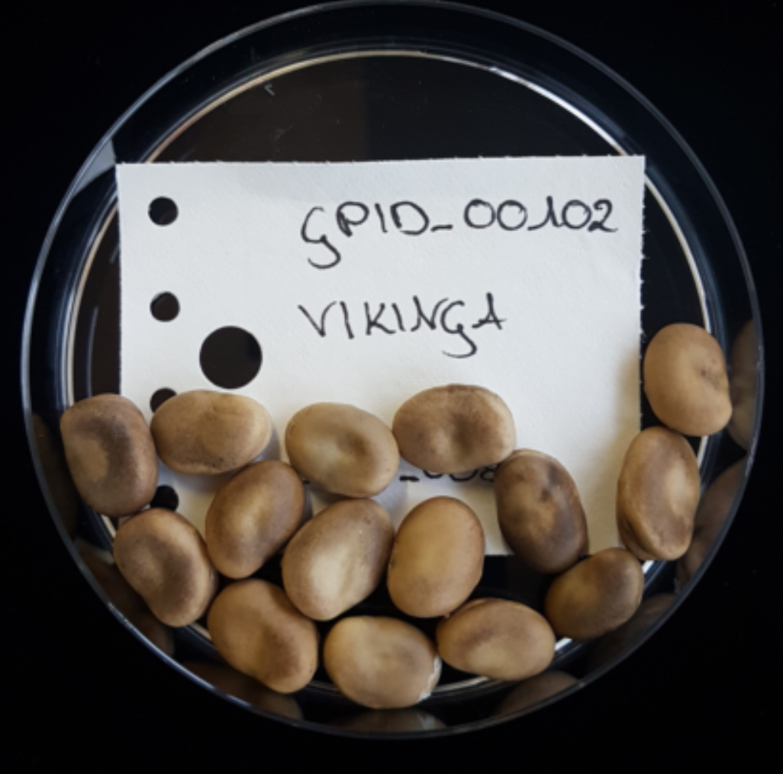
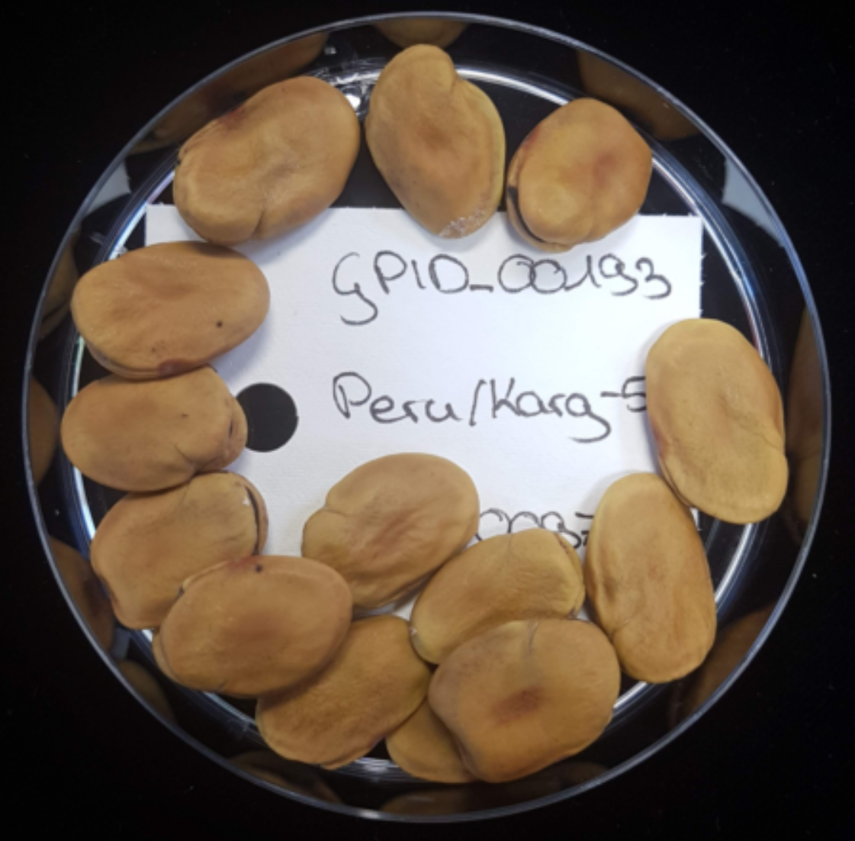
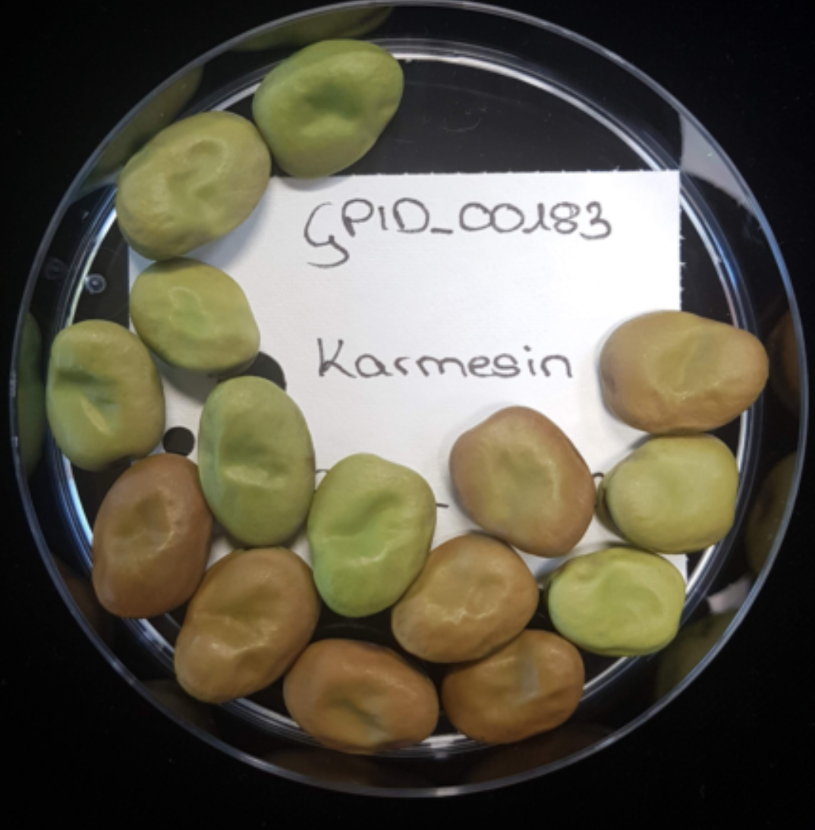
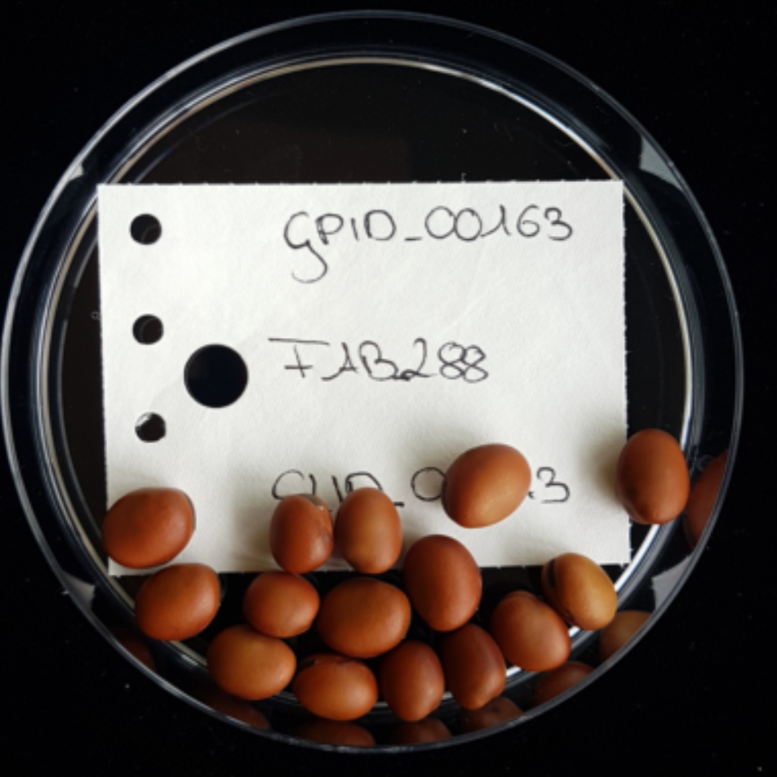
17
En passant we detect here further scales of genetic diversity and segregation.
Les us again take the segregation of our Mendelian F2-generation as example.
Genotypes‘ segregation such as
AA, Aa, aa; with genotype ratios of 1 : 2 : 1.
Genetic variance: σ²_{G}=σ²_{A}+σ²_{D}
Phenotypes‘ segregation such as
resistant vs. susceptible: σ²_{P}=σ²_{G}+σ²_{GE}
Genotypes differ for their share of genes inherited from P1
All genes inherited from P1: AABB
Most genes inherited from P1: AABb; AaBB
Half of genes inherited from P1: Aabb; aaBB; AaBb
Few genes inherited from P1: Aabb; aaBb
No genes from P1: aabb
F2-Var. for genetic dose inherited from P1: σ²_{P1} = 1/(8N)
www.suscrop.eu/projects-first-call/profaba; © Windhorst

Slide 18
En passant we detect here two further scales of genetic diversity and segregation.
Further: Beyond the ‚usual‘ segregation that leads to genotypic variance ‚for‘ traits.
Genotypes‘ segregation such as
AA, Aa, aa; with genotype rations of 1 : 2 : 1.
Genetic variance: σ²_{G}=σ²_{A}+σ²_{D}
Phenotypes‘ segregation such as
resistant vs. susceptible: σ²_{P}=σ²_{G}+σ²_{GE}
Genotypes in F2 fall in homozygosity levels.
Fully homozygous: AABB; Aabb; aaBB; aabb
Partly homozygous: AABb; AaBB
Zero homozygous, i.e. fully heterozygous: AaBb
F2-Variance for level of homozygosity: σ²_{H}=1/(4N)
(N=number of independently segregating genomic segments)
Genotypes differ for their share of genes inherited from P1
All genes inherited from P1: AABB
Most genes inherited from P1: AABb; AaBB
Half of genes inherited from P1: Aabb; aaBB; AaBb
Few genes inherited from P1: Aabb; aaBb
No genes from P1: aabb
F2-Var. for genetic dose inherited from P1: σ²_{P1} = 1/(8N)
18

Slide 19

An example of a successful (marker-assisted) Backcross procedure.
Salameh, A., Buerstmayr, M., Steiner, B. et al. Effects of introgression of two QTL for fusarium head blight resistance from Asian spring wheat by marker-assisted backcrossing into European winter wheat on Fusarium head blight resistance, yield and quality traits. Mol Breeding 28, 485–494 (2011). DOI 10.1007/s11032-010-9498-x
https://scabusa.org/pdfs/nfhbf15_proc_complete.pdf
The so-called Backcross procedure is a recurrent hybridi-zation-plus-selection protocol. In its easiest version, one desirable allele for a desirable trait expression (such as ‘resistant’) is introduced to substitute the existing un-desirable allele in an otherwise very fine cultivar.
Define the elite cv. (lacking this desirable allele) as Recurrent parent. Define the Donor of the sought-for feature. The purpose of repeatedly Backcrossing is to recover the elite type of the Recurrent parent, except for the desirable allele (contributed from Donor; the undesirable allele is hence ‘kicked out’ of the Recurrent parent). The backcross procedure as described here is rather easy if the desired trait expression is simply inherited (monogenic), dominant, thus easily recognized in the phenotype of the backcross offspring individuals.
More complex cases of course can be visualized. The mentioned example here is with two loci, the trait is fungus resistance in wheat.
Fusarium head blight resistance is mostly showing intermediate gene action, hence not dominance- recessive phenotype segregation.
19

Slide 20
Backcross scheme, based on phenotypic verification of the sought-for feature. Donor allele is either assumed as dominant (left scheme) or as recessive (right-side scheme).
20
Focal allele a
is recessive.
That’s not easy.
Focal allele is A dominant.
That’s easy.
Elite parent
Has ‚it‘
X
Lost ‚it‘
useless
?
The first backcross is the first segregating genera-tion. You to select those (heterozygous) individu-als that carry the desired allele ‚A‘ – they show the (dominant) phenotype. Only those are further backcrossed; etc.
The BC1 generation segregates, yet, since the desired allele is recessive, you can not phenotypically differentiate (‚AA‘ looks like ‚Aa‘). Therefore you have to self-fertilize in parallel to the further back-crossing. Retrospectively you will see which ones segregated upon selfing (good) or not (useless).

Slide 21
Again the same. ‘Seed twice remember better’.
Backcrossing as it is classically conducted, based on phenotypic verification of the sought-for feature. The sought-for donor allele is either dominant (left scheme) or recessive (right-side scheme).
Phenotype difference between ‚Aa‘ and ‚aa‘. Take Aa for fur-ther backcrossing
No phenotype difference between ‚Aa‘ and ‘AA‘.
Only from selfed offspring, you can identify the heterozy-
gous members of BC1(F1). Continue with BC1(F1) being
‘Aa’ for further backcrossing
BC1(F1)
BC1(F1)
Still not yet clarified: how do you finally come to the desired genotype which must be homozygously ‘good’; not segregating any more!?
21

Slide 22

(DNA-marker assisted) Foreground and
(DNA-marker assisted) Background Selection when realizing a Backcross scheme.
Marker-assisted Foreground Selection
With this, you follow the main task; you make sure that you do not lose the desired allele(s) during the steps of Backcrossing.
Instead of phenotypically following the segregation of that allele, you may indirectly follow it: Follow the segregation of a (highly, fully) linked DNA-marker allele (SNP*). This is especially useful if the desired trait expression is recessive (whereas your indicative SNP allele will be co-dominant – you know, SNPs are indeed ☺ co-dominant**).
Marker-assisted Background Selection
With this, you push the kicking-out of the donor-genome and the recovering of max. possible share of the elite ge-nome. You need many, evenly dispersed DNA-markers for this purpose. A specific problem is ‘linkage drag’ in the chromosomal vicinity of the locus of the desired allele.
*SNP: Single Nucleotide Polymorphism. Outdated marker types: Isozymes, RAPD, RFLP, SSR, AFLP, DArT, DArTseq, etc.
**Do not mix up ‚intermediate‘ with ‚co-dominant‘
Desired
Un-desired
BC₁(F₁)-individual
~25%
Parent 1
(Elite)
Parent 2
(Donor)
~75%
22

Slide 23
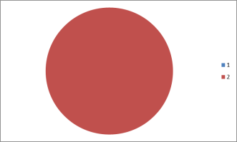
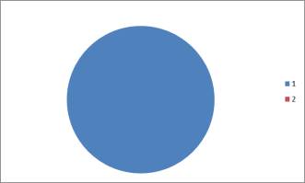
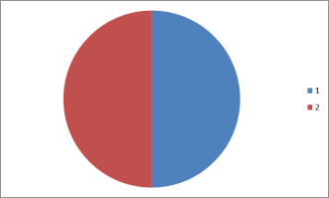


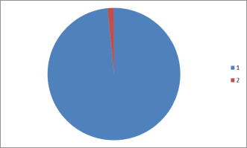
A slightly more detailed inspection of the backcross process.
X
Cross
Donor
Recurrent parent
Conduct 1st backcross
X
F₁
Recurrent parent
Make 2nd backcross
with selected BC₁ plants
X
BC₁(F₁)
Recurrent parent
Make 3rd backcross
with selected BC₂ plants
X
BC2(F₁)
Recurrent parent
et cetera
et cetera
Arrive at BC₅
or higher BC generation
BC5(F₁)
23

Slide 24

Foreground selection. See that the Backcross generations segregate. Select.
Backcross only with ‚good‘ plants.
X
Cross
Slice size in-
dicates share
of Donor and
elite Recurrent
parent genome
Donor
Recurrent parent
Make 1st backcross
X
F₁
Recurrent parent
Make 2nd backcross
with selected BC₁ plants
X
BC₁(F₁)
Recurrent parent
BC₁(F₁)
et cetera
et cetera
Homozygous for non-desired allele
Heterozygous for desired allele
24

Slide 25
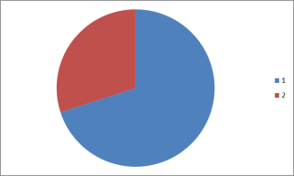
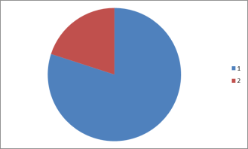
Background selection. BC1 (and following generations) vary for their actual share
of Recurrent Parent genome. Select for highest dose!
X
Cross
Donor
Recurrent parent
Make 1st backcross
X
F₁
Recurrent parent
Make 2nd backcross
with selected BC₁ plants
X
Recurrent parent
BC₁(F₁)
et cetera
et cetera
Discard BC-individu-als with high share of Donor genome.
25

Slide 26
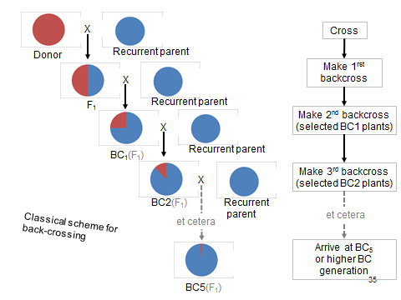
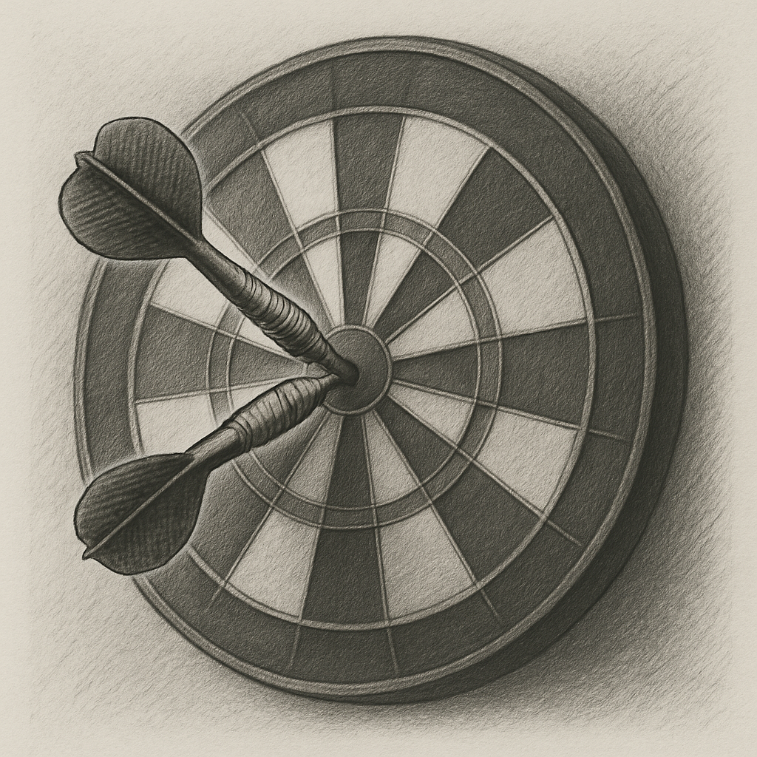
As we arrive at BC₅ or higher BC generation, the BC-plants still segre-gate at the target locus; in simple cases in a 1 : 1 version for ‘homozy-gous-like-recurrent parent’ and ‘heterozygous’. But: At this locus, we want to get it ‘homozygous like Donor’. Thus, we have to once-self-fertilize and select among offspring for the target (homozygous) type.
BC5(F₁)
One ultimate step of selfing and
selection for homozygosity of the sought-for feature.
BC5(F₂)
BC5(F₂)
26

Slide 27
From here you may go to UNPLAB-BrMeth_Ch-11[TheFour GS]
What did we study in this chapter?
First: The traditional, phenotype-based cleaning of a released cultivar from any kind of off-types, whatever the reason of their emergence may be, not only mutation. This is called ‘Maintenance Breeding’, this may consume more time and effort from a decent* breeder than the breeding of new cultivars.
Second: How to exploit one (or few) markers linked to the target locus, to conduct Foreground Selection in the Back-crossing process (this is to not lose the target allele);
and how to exploit many, evenly-spread markers to conduct Background Selection in the same Backcrossing process … to exploit the natural variation for the genome dose of the recurrent elite parent (this is to arrive earlier at a high-enough level of isogeneity of the backcross product to the initial elite type).
*do not mix up ‚descent‘ and ‚decent‘, neither in spelling nor in pronunciation ;-)
27
27

